Slide 1
EHDS - highlights
……as of October 2024
18. 10. 2024, K. Jiráková

Slide 2
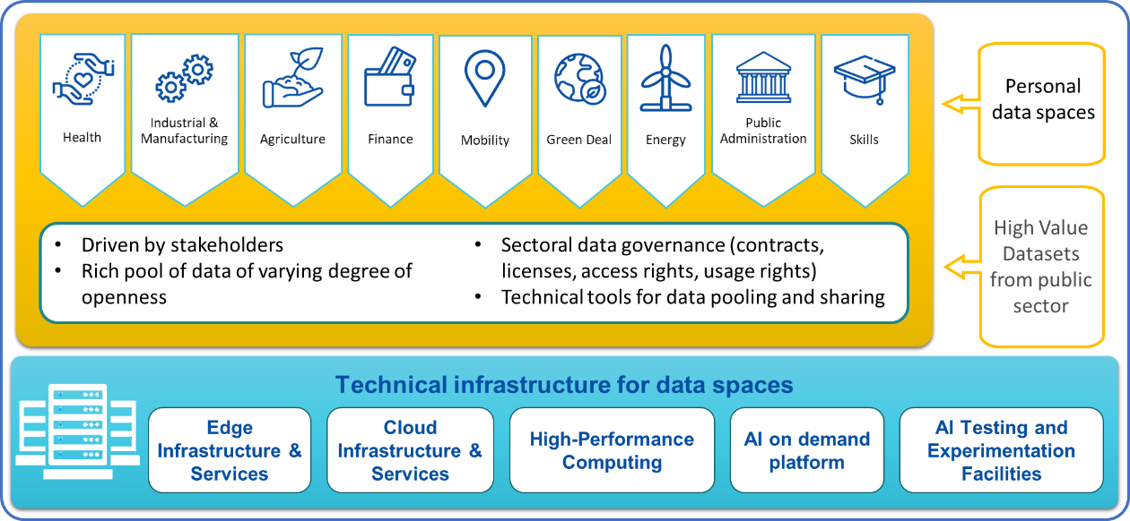
Health is the first common EU data space
Source: EC, DG SANTE
¹ How to make common European data spaces a reality | data.europa.eu

Slide 3
Regulatory implementation of the EHDS
Deadline for main implementing acts
2024
2026
2028
2030
2032
2034
2036
Entry into force
Entry into application
General application
Exchange of 1st group of priority categories
Primary uses of health data (Chapter II)
patient summary, electronic prescriptions and dispensations
Exchange of 2nd group of priority categories
medical images, medical tests results and discharge reports
Only sell compliant products 1st categories
EHR Systems certification (Chapter III)
Only sell compliant products 2nd categories
Secondary use in general
Secondary uses of health data
(Chapter IV)
Selected categories
Genomics, omics, wellness applications
connections
Third countries
Deadline for main implementing acts
Source: EC, DG SANTE
Entry into application
Entry into force

Slide 4
Building on existing cooperation
MyHealth@EU under Cross-border Healthcare Directive
Voluntary system for exchanging patient summaries, prescriptions and dispensations (≈ first group of priority categories)
Health Data structured according eHealth Network guidelines
14 MS live with at least one service, 6 more scheduled to go live with first service(s) this year
Evolution of MyHealth@EU for the EHDS
Voluntary => mandatory
New services
New data categories
Source: EC, DG SANTE

Slide 5
Preparations on national level (1)
Prepare one or more digital health authorities to become responsible for implementing Chapter II of the Regulation.
Prepare a national contact point for digital health for the provision of services linked to cross-border exchange of personal electronic health data.
Ensure connection of all healthcare providers to their national contact points for digital health.
Ensure that pharmacies operating on their territories, including online pharmacies, are enabled to dispense electronic prescriptions.
Preparing the entities for setting up a digital testing environment for the assessment of harmonised components of EHR systems.
Source: EC, DG SANTE

Slide 6
Preparations on national level (2)
Prepare to designating the market surveillance authority or authorities responsible for implementing Chapter III of the Regulation.
Prepare health professionals in order to understand and effectively exercise their role in the primary use of and access to electronic health data.
For more details, check the tasks for national authorities and Member States in the provisional agreement on the EHDS Regulation!

Slide 7
Secondary uses of health data – Implementation
Entry into force
Deadline for main implementing acts
2021
2022
2023
2024
2025
2026
2027
EHDS Regulation
Negotiation
Development of main Implementing acts
Implementing acts
INCEPTION
TEHDaS
TEHDaS 2
PILOT
HealthData@EU Pilot
HDABs and TEFs for AIs
HealthData@EU Central Services
HDABs set up + HealthData@EU Scale Up
SCALE UP
Capacity building
Data quality and utility label (QUANTUM)
EHDS2 Compliance checks
OPERATIONS
EHDS2 Stakeholders Engagement
Entry into force
Deadline for main implementing acts
Source: EC, DG SANTE

